Slide 1

Build your code-first app with Azure AI Agent Service
Carlotta Castelluccio
Senior AI Advocate @Microsoft
Marlene Mhangami
Senior Developer Advocate @Microsoft
In partnership with

Slide 2
Chapter 1
Setting the scene
Notes:
[Carlotta]
Alright, let's set the stage for the next 60 minutes, which we will spend exploring AI agents through an end-to-end example created with the Azure AI Agent service that addresses a specific use case.

Slide 3







Evolution of LLM-based Solutions
Memory
history of work
User Proxy Agent
CoordinatorAgent
LLM
Agent
LLM
conversation
LLM
question
query
data
prompt +
data
prompt
answer
Service
Agent
LLM
Retrieval
Agent
LLM
Analytics
Agent
S
LM
Coding
Agent
SLM
document
summary
Search
docs
input
output
query
data
data
Web Service
Search
databases
docker
docs
No Agent
Very narrow one shot task
Ex: log to JSON
Single Agent
Very clearly scoped iterative task
Ex: providing an answer with supporting evidence to a complex question
Multi-agent Systems
Wide scope complex use case requiring diverse skills
Ex: Propose 2 Instagram marketing campaigns including assets that would leverage the top 2 recent trends in our past quarter US Sales to boost our mailing list user base and predict the impact of each campaign
VALUE
Notes:
[Carlotta]
Before jumping into our sample, let me just do a step back and start with the ‘why’, why do we need agentic AI and what’s the benefit they brought wrt just consuming LLMs.
Let’s look at the AI progression in the last year or so:
We started with interacting directly with an LLM. LLMs can take natural language as input and speak many languages, can process multimodal inputs/outputs. They can help carry out tasks AND act as tutors. In terms of user experience, they provide a simple back and forth chat with users. They can also be grounded on private data, to be able to provide more accurate responses (using RAG) or customized through fine-tuning techniques.
Next we have triggered agents, this is one step further, they are goal based and can take actions independently. Theya re still based on LLMs, as the model is the chat engine, but they also have access to data (or search tools) and actions. They are semi-autonomous, because they may require minimal user intervention but they could also ask other agents for input. Given a goal, they will work to achieve that goal without you knowing in advance exactly how it's going to do that or what steps it's going to take. They also have a memory, as agentic framework handles the conversation context and truncation for you.
As I mentioned before, an agent can work with another agent. Multi-agents systems can be built to address more complex scenario where we want to provide fault tolerance (one agent reviewing the work of the other), specialization (each agent specialized in different tasks) and scalability (for large workloads).

Slide 4

An agent needs to accomplish 3 things:
Reason over a provided business process
Retrieve context to complete the process
Perform an action for the end-user
Notes:
[Carlotta]
In short, an agent should be able to accomplish 3 things:
1. Reason over a provided business process
2. Integrate with data sources for context
3. Orchestrates a process towards achieving a goal by performing actions
An LLM-based agent is a framework that sits above one or more models that allows you to do complex long running tasks and that can take action on your behalf.

Slide 5
How can an agent help us?
Notes:
[Carlotta]
How can agent help us? (our specific use case)
Build an agent to help us analyze sales data
Instead of manually querying databases or running reports, we use an AI agent to automate and simplify this process.
Specifically, an agent can help
✅ Aggregates sales data from multiple sources (databases, APIs, spreadsheets). ✅ Detects trends and anomalies (e.g., seasonal spikes, underperforming products). ✅ Generates insights & visualizations (charts, summaries, revenue breakdowns). ✅ Automates reporting to send insights via Teams, dashboards, or email.
Specifically the agent

Slide 6

Use case
Working for an e-commerce selling camping equipment
Want to analyze sales data
Notes:
[Carlotta]
Through out this talk, we'll pretend we're a succcessful outdoor and hiking equipment company – and we'll use the power of AI to analyze our sales data
Here’s our use case, we have an e-commerce selling camping equipment..called Contoso
Of course, we want to keep improving so we opt to analyze our sales data but how do we do that?
Reimaging a UX with GenAI that our sales team can use

Slide 7
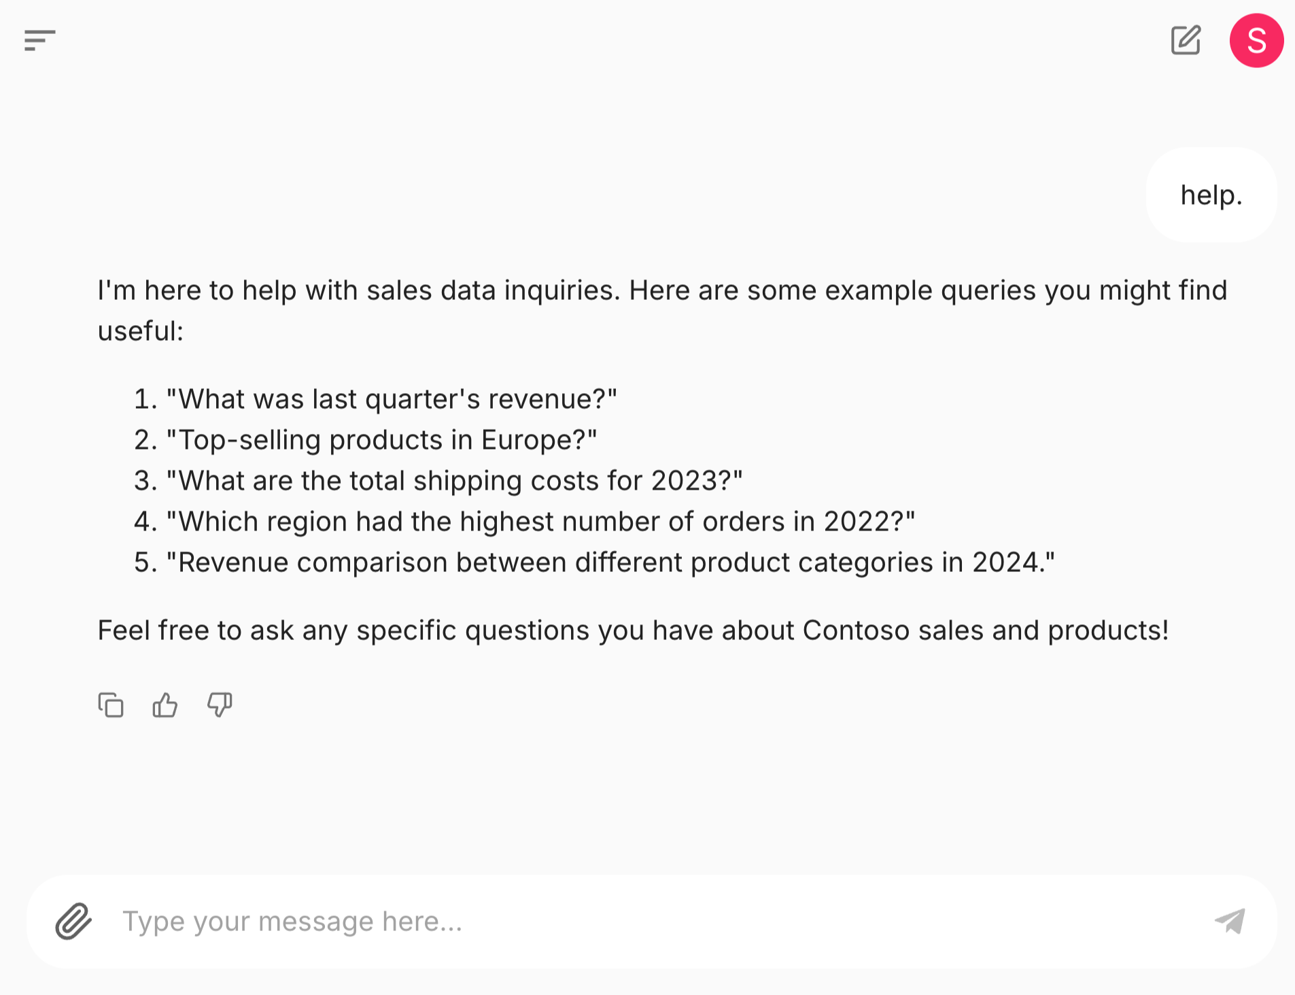
Demo – Contoso Sales Agent
An agent built with Chainlit and the Azure AI Agent Service
Notes:
[Carlotta]
https://a4plaj2iwguui2-ca.redhill-6b7457ea.eastus2.azurecontainerapps.io/sales/
The app I am going to show you is a conversational agent that can answer questions about sales data, generate charts, and create Excel files for further analysis.
The app is built with Azure OpenAI GPT-4o , the Azure AI Agent Service and the Chainlit Conversational AI web framework to enable this UI.
The app uses a read-only SQLite Contoso Sales Database with 40,000 rows of synthetic data. When the app starts, it reads the sales database schema, product categories, product types, and reporting years, then adds this info to the Azure AI Agent Service instruction context.
The Contoso Sales Agent app is deployed to Azure using Azure Container Apps. The app is fully asynchronous, uses the FastAPI framework, and streams all responses to users in real-time.
1. As you can see, there are some prompt starters in the center of the window. So, let’s start by selecting one of those and especially the ‘Help’ starter to understand how the agent can helps us.
2. Now, let’s try with a prompt specific for the financial use case. Create a vivid pie chart of sales by region.
The LLM will first select the tool to use to address the user request, among the pre-defined tools configured when setting up the agent. So it will pick the ask_database function and generate a SQL query to use as parameter. It will then call the fetch_sales_data_using_sqlite_query
function to execute the query and return the results that you can see printed here. After that, the LLM will generate Python code to create a pie chart based on the query results and will execute it inside a Python sandbox enabled by the code interpreter tool.
3. Next, we'll ask about beginner-friendly tents. Submit the prompt: What beginner-friendly tents does Contoso sell?
The sales database has limited knowledge of the products as the focus of the database is sales data, so the LLM is not really able to help here.
4. Then, we'll going to upload a Contoso Tents Datasheet to the Agent chat. This will allow the agent to provide more detailed information about the tents. The AI Agent Service will vectorize the PDF and store the data in a vector store and the LLM will be able to access the data using hybrid (semantic and keyword) queries.
Resubmit question: What beginner-friendly tents does Contoso sell?
Now the agent has access to the tent data through a tool called File Search and can provide more detailed information.
5. Now, we're going to combine the data from the sales database and the tent datasheet to provide a more detailed analysis.
Submit the prompt: Show sales of BACKPACKING TENTS by region and include a brief description in the table about each tent.
As always, we can see the chain of thought by expanding the section of Used tools.
6. Finally, let's use the AI Agent Service, the LLM, and the code interpreter to generate a report on the sales of beginner-friendly tents in Excel format.
Submit the prompt: Create an excel file
The LLM will generate the Python code to create the Excel file. You can download the file by selecting the download link and open in Excel.

Slide 8
Chapter 2
How does the Contoso Sales Agent work?
Notes:
[Marlene]
Now we are going to dive into how we built Contoso Sales Agent
There are lots of Frameworks to help build Agents
Leave developers with a lot of complexity
For example, developers must handle state, context, tool orchestration, and scaling, which can be challenging.

Slide 9

Azure AI Foundry
Public Preview
Azure AI Agent Service
Securely build, deploy, and scale AI agents with ease
Rapid development and automation
Extensive data connections
Flexible model selection
Enterprise-grade security
ai.azure.com
Notes:
[Marlene]
We’re are going to use the new Azure AI Agents Service.
It addresses the complexity … by allowing you to build, deploy, and scale AI agents with ease
Simplifies development:
As a fully managed service:
State management
Context management (decides what tool to call)
2. Integration with extensive ecosystem of knowledge and action tools
3. Support for many model families
4. Built-in enterprise readiness

Slide 10





Enterprise-grade security
Tracing and monitoring
Content filters
Bring your own storage and search
Private virtual network support
Keyless setup and authentication
Notes:
[Marlene]
Callout: None of this would be possible with out enterprise foundation
[Marlene]
Security is a top priority when building agent apps in an enterprise environment
Agents handle sensitive data, interact with external systems, and must be protected from misuse
Azure AI Agent Service is built to meet rigorous enterprise requirements, with features like:​
1. Support tracing and monitoring
Ensuring agent is not hallucinating
2. Content filters
Protection against prompt ingestion attacks
3. Bring your own storage and search for custom data handling
4. Private virtual networks (VNET) to secure data traffic (coming soon)​
5. Keyless setup and authentication, and much more

Slide 11
Solution Architecture
Contoso Sales Agent App
Query Function
Chainlit
Azure AI Agent Service
Instructions
Models
Tools
Tools
Grounding with Bing Search
Function Calling
Code Interpreter
File Search
Grounding with Bing Search
Function Calling
Code Interpreter
File Search
Notes:
[Marlene]

Slide 12






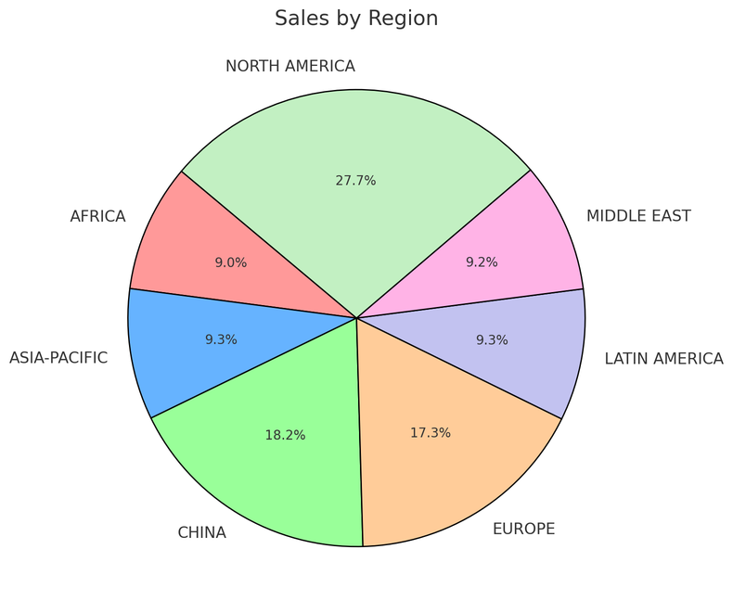
AI Agent Service in Action
Step 1: Create an Agent
Step 2: Create a Thread
Step 3: Run the Agent
Step 5: Check the Run status
Step 6: Display the Agent’s Response
Agent
Contoso Sales Agent
Instructions: You are an advanced sales analysis agent for Contoso, specializing in assisting users with sales data inquiries
Thread
Sales analysis
Run 1
User’s message
Tell me the total sales by region
1
Function Calling Tool
Query SQLite DB
Model
Agent’s message
Here is the sales:
Europe: $15478.00
America: $78792.00
2
Create message
Your data (optional)
Azure AI Search
Files (local or Azure Blob)
User’s message
Show as a pie chart
Run 2
Tools (optional)
File Search Code Interpreter
Function Calling Bing Search
Azure AI Search Microsoft SharePoint
Microsoft Fabric Azure Logic Apps
Azure Functions
OpenAPI 3.0 specified tools
1
Code Interpreter Tool
Create a pie chart
Agent’s message
2
Create message
Notes:
[Marlene]
So, this is going to be a bit more of a drill down of agents in action
High level – this is how the AI Agent Service works
Create/define agent
Create a thread which is a unit of conversation (between agent and user)
Run the Agent
Check status till complete
Show output
Now…Break this down further
An agent is composed of:
a set of nature language instructions
a model that you choose (non openai support)
Option based on the setup you choose to use your own resources to store your customer data
With what we call our standard setup you can use your own Azure Storage for files, Azure AI Search for vector store creation, and coming soon Cosmos DB for threads
Lastly, ability to easily configure knowledge and action tools
2. A Thread is created
Conversation session that stores messages
3. When the user sends their first message, a run is triggered
A “run” is the activation of an agent based on the thread’s content
The agent uses its configuration and the thread’s messages to perform tasks, calling models and tools as needed.
The last step in a run, the agent appends messages to the thread.
4. As you can see a single thread can have multiple runs.
Explain example on the screen

Slide 13
Function calling
The capability of LLMs to take in ​
user-defined functions as inputs & generate structured outputs.
Notes:
[Marlene]
Now we’re going to look at some of the building blocks…aka agent tools
Function callings allows allows agents to interact with other systems
OpenAI and other models support function calling
You provide a definition of a function call
If the LLM detects conversation that would satisfy a function, you get structured output
It’s then up to your app to decide what to do with the structured data
You are responsible for making the function call yourself on the client side
In this example we are about to demo, execute a SQL query and return data as context to the model
Your will see built-in support for function calling in Azure AI Foundry SDK will simplify this experience
The SDK will parse and execute these functions within streaming (still client-side)
Service-side support with azure functions, logic apps (coming soon)

Slide 14
Demo 2: Azure AI Agent Service
1. Dynamic SQL Generation with Function Calling
Notes:
[Carlotta]
In the 1st demo we’ve seen our agent in action, but I shoed you as a kind of a black box. Now we are going to break it down and look at the code behind.
Let’s start by enabling our agent with function calling tooling to execute SQL queries.
In main.py, we have a main logic of the app. Here we retrieve the required parameters declared as env variables and then create a project client, which is the single client we use to interact with all the AI services available in Azure AI Foundry and accessible via our project (which is our workspace).
Step 1: Define a function for your agent to call
async_fetch_sales_data_using_sqlite_query is a function that executes SQL queries against the database and returns results as a Json object
The Azure AI Agent service makes it easy to call functions, by using docstring to specify signature, outputs, inputs. The LLM which is the agent engine, process this information to be able to make decisions on when and how to call this function to provide a response to the user.
Step 2: Initialize agent toolset with user functions
Toolset: When using the toolset parameter, you provide not only the function definitions and descriptions but also their implementations.
Agent SDK will parse and execute these functions within streaming
However, this is still client-side execution!
Step 3: Create an agent and give it access to function calling tool, sqllite db and instructions. Instructions include an agent persona, a detailed definition of the tasks to perform and styling guidance on how to show the results.
[All tools] Step 4: Create a thread. A conversation session between an Agent and a user. Threads store Messages – that can include text, images and other files- and automatically handle truncation to fit content into a model’s context.
[All tools] Step 5: On user input, create message and stream. Post response when done.
Questions:
What are my sales by region
Create a vivid pie chart to show my sales data by region - as you can see this fails, because the agent doesn’t have access to any tools that allows it to create graphs.

Slide 15
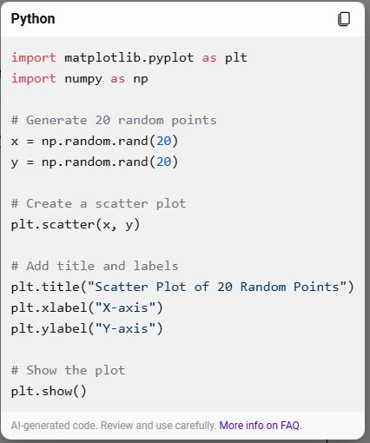
Demo 3: Azure AI Agent Service
Dynamic SQL with Function Calling
Code Interpreter
Notes:
[carlotta]
To give our agent the power to visualize data, let’s add the code interpreter tool.
It’s a built-it out of the box tool
You don’t need to define it
Service-side execution: Agents calls and executes tool for you
How to set up code interpreter:
Update our instructions (instructions file now contains reference to code interpreter)
Initialize code interpreter tool
Create an agent and enable code interpreter and function calling
Passed in via toolset
Questions
1. Create a vivid pie chart to show my sales data by region
Once the task is complete, the pie chart image will be saved in the files folder. Open the folder in VS Code and click on the image file to view it.
2. Download the sales by region data
Once the task is complete, check the files folder to see the downloaded file.
Note: should be csv
3. What brands of tents do we sell?
It seems that the sales data does not include a "brand" column. The available data includes categories such as product type, main category, region, and more. If you have any other specific analysis or visualization in mind, please let me know!
Fails: need more information to answer this question

Slide 16
Demo 4: Azure AI Agent Service
Adding Context with File Search
Notes:
[carlotta]
Extend the knowledge of our agent with Knowledge tools!
Now add build-in tool called File Search
Again, this is an out of the box tool so implementation is handled for you by the service
How to set up file search:
[Show pdf] – file of additional knowledge we want agent to access
Update instructions (now include reference to the vector store)
[Dive into utilities.py]
1. You upload file and create vector store (type of search index)
Uploading our Contoso-tents-datasheet
Vector store is a type of search index
2. Initialize the file search tool and attach this vector store
3. Lastly, create an agent enable all the tools
Questions
What brands of tents do we sell?
What product type and categories are these brands associated with?
What beginner tents do our competitors sell and include prices? - fails , we do not uploaded data about our competitors

Slide 17

Demo 5: Azure AI Agent Service
Adding Context with Bing Grounding
Notes:
[Carlotta]
Extend the knowledge source of our agent with the Bing Search tool! Grounding with Bing allows your app to search for information relevant to the conversation.
A big limitation of LLM’s is they don’t have access to real-time data.
The agent combines data from the Contoso sales database, the Tents Data Sheet, and Bing Search to provide comprehensive responses, so the results will vary depending on the query.
Create Bing resource and connect it to your project
Note: we did this before the demo
Initialize the Bing tool using your connected resources
Lastly, create an agent enable all the tools
Questions
What beginner tents do our competitors sell and include prices?
Show as a bar chart
Show the tents we sell by region that are a similar price to our competitors' beginner tents.
Download the data

Slide 18
Chapter 3
What if we want to build a multi-agent application?
Notes:
[Marlene]
Finally, we’re going to touch on multi-agent.
What if we wanted to build our app using a multi-agent solution

Slide 19
Multi-agent Pattern
An AI multi-agent system consists of multiple intelligent agents that interact and collaborate to solve complex tasks, share information, and achieve goals autonomously or semi-autonomously.
Notes:
[Marlene]
An AI multi-agent system consists of multiple intelligent agents that interact and collaborate to solve complex tasks, share information, and achieve goals autonomously or semi-autonomously.
This pattern can be applied to a wide range of use cases
- Including simple tasks, such as generating a report
- Or as complex solutions such as automating large-scale workflows

Slide 20







Deploy agents with Azure AI Foundry
1
Single-agent
2
Multi-agent
Orchestrate them together with AutoGen and Semantic Kernel
Managed agent micro-services
State-of-the-art research SDK
Production-ready and stable SDK
Ideation
Production
Notes:
[Marlene]
Now I am going to talk about our strategy is across Open Source SDKs and Azure AI Foundry:
When building a new multi-agent solution, you should start with Azure AI to quickly build and deploy most reliable, scalable, and secure agents.
You can then orchestrate these agents using one of Microsoft’s two multi-agent orchestration libraries: AutoGen and Semantic Kernel.​
AutoGen: built by Microsoft reasearch (cutting edge, state-of-the-art research sdk)
Pros: always up date, but you might hit breaking changes
Semantic kernel: take the Microsoft research and packages it up and GA it: it so we don’t have breaking changes (stable, product-ready and stable sdk)
Coming soon: Orchestration in AI Foundry
All are staying! All have a place to support different needs

Slide 21




AutoGen/Semantic Kernel
app
Group chat
Chat state
User proxy
Data Analyst
SQL
agent
Custom function
Agent service
Agent service
Agent service
Code
interpreter
Bing Search
File Search
Notes:
[Marlene]
How would we implement our app using multiple agents
Why multi-agent
Didn’t want to drop a boat load of prompts into one single agent
Introduces a lot of complexity as you add more tools
One solution: Specialized agents that each have a specific part of the prompt and are responsible for a specific task
Implement our app as Multi-agent app:
SQL agent: gave it data and functional calling action tool to be able to write and execute queries
Data Analyst: take all the results and reason over them with its business knowledge
aka file search tool to access our product documentation and catalog
And Bing search to have access to real-time information
User proxy: the only agent that has the power to actually do anything (send messages to external systems)
For example, send queries to other systems or execute code
As the number of agents in your multi-agent system grows, the burden of configuring and maintaining them grows proportionally.
-one solution the industry uses to help with this is something called “maker-checker” or as some say “debating agent pattern”
[New] Quality Engineer: check what the SQL agent proposed
Both agents are provided the same instructions and tools, and can only move to the next step in process if both agree
This significantly reduces the chance of errors because the probability that both agents make the exact same mistake is extremely low
4 agents in this setup
Lastly, pass it back to Carlotta to give us a brief summary of what we have learned today and our main takeaways

Slide 22
Chapter 4
Takeaways
Notes:
[Carlotta]
Learn about Agents
Learn about Azure AI Agent Service
Start small

Slide 23
Learnings and next steps
Build agents quickly with Azure's fully managed agent service
Use Azure AI Agent Service to get out of the box tools like Bing, Azure AI Search, function calling, code interpreter, file search, and more
Explore frameworks Semantic Kernel and Autogen to implement advanced functionalities like multi-agent systems
Use UI or code to build your agent
Notes:
[Carlotta]
To summarize, key takeaways
1. Build agents quickly with Azure's fully managed agent service
2. Use Azure AI Agent Service to get out of the box tools like Bing, Azure AI Search, function calling, code interpreter, file search, and more
3. Explore frameworks Semantic Kernel and Autogen to implement advanced functionalities like multi-agent systems
4. We used code but you can….use UI or code to build your agent

Slide 24
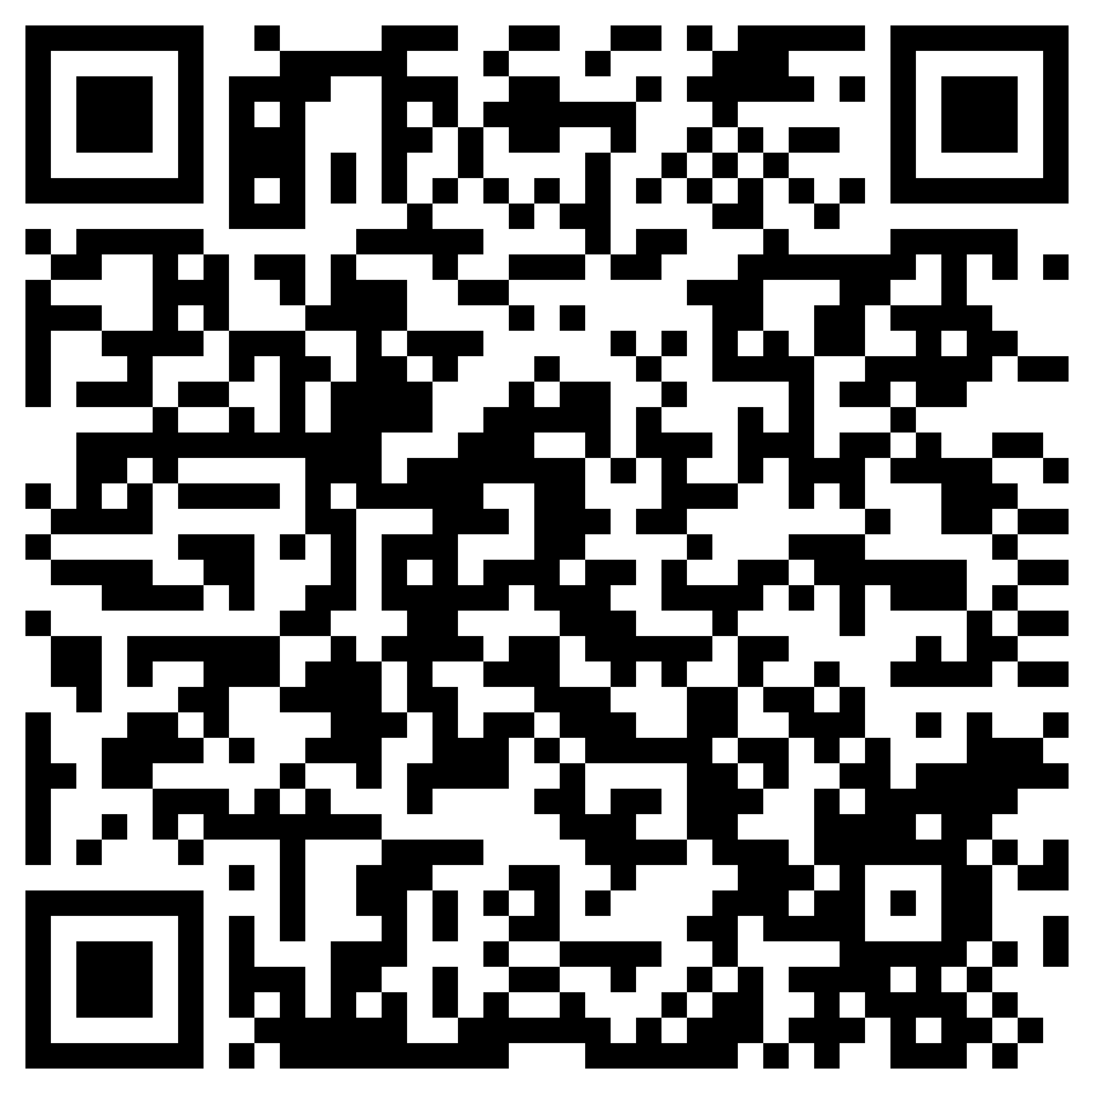
Thank you
https://aka.ms/build-your-code-first-ai-agent
Notes:
[Carlotta]
All the demos are here!

Slide 25
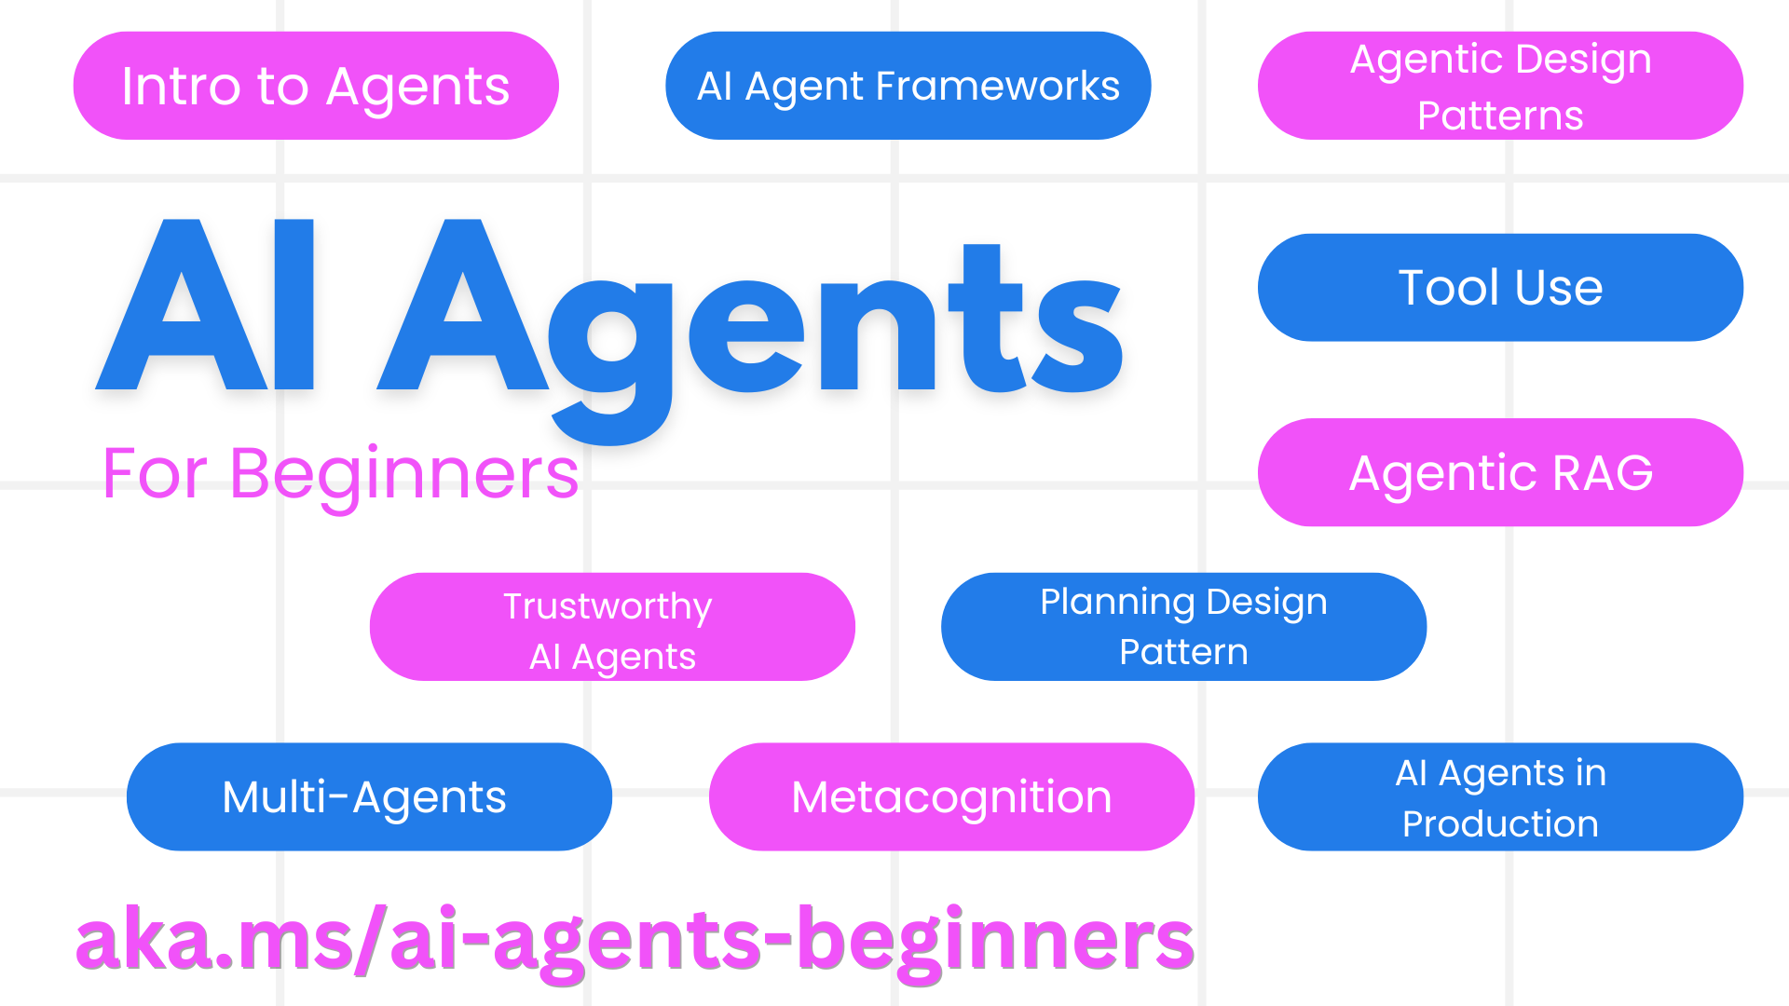
Notes:
All the demos are here!

